Slide 1
Stocks and Industries Analysis based on the S&P 500
Boris Li
January 2021

Slide 2
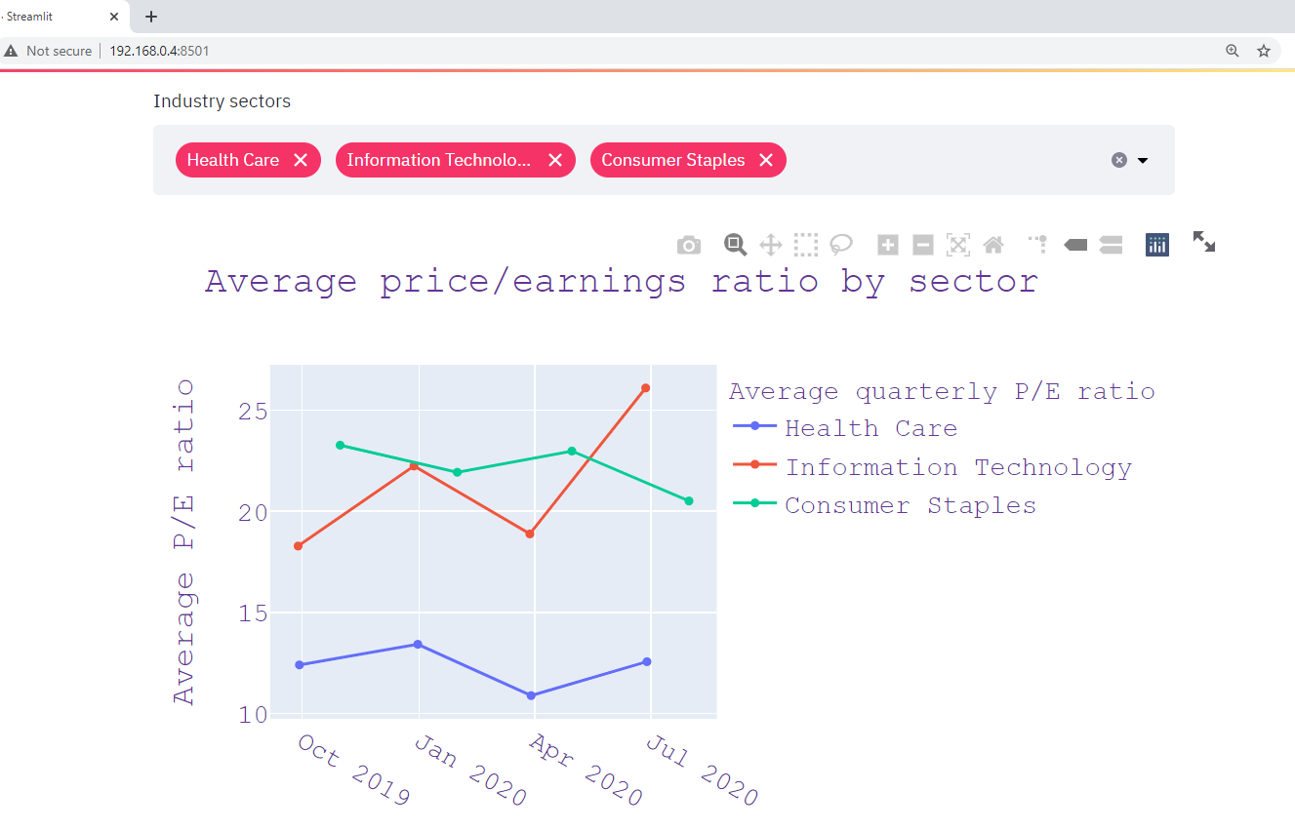
Sector-level aggregation

Slide 3
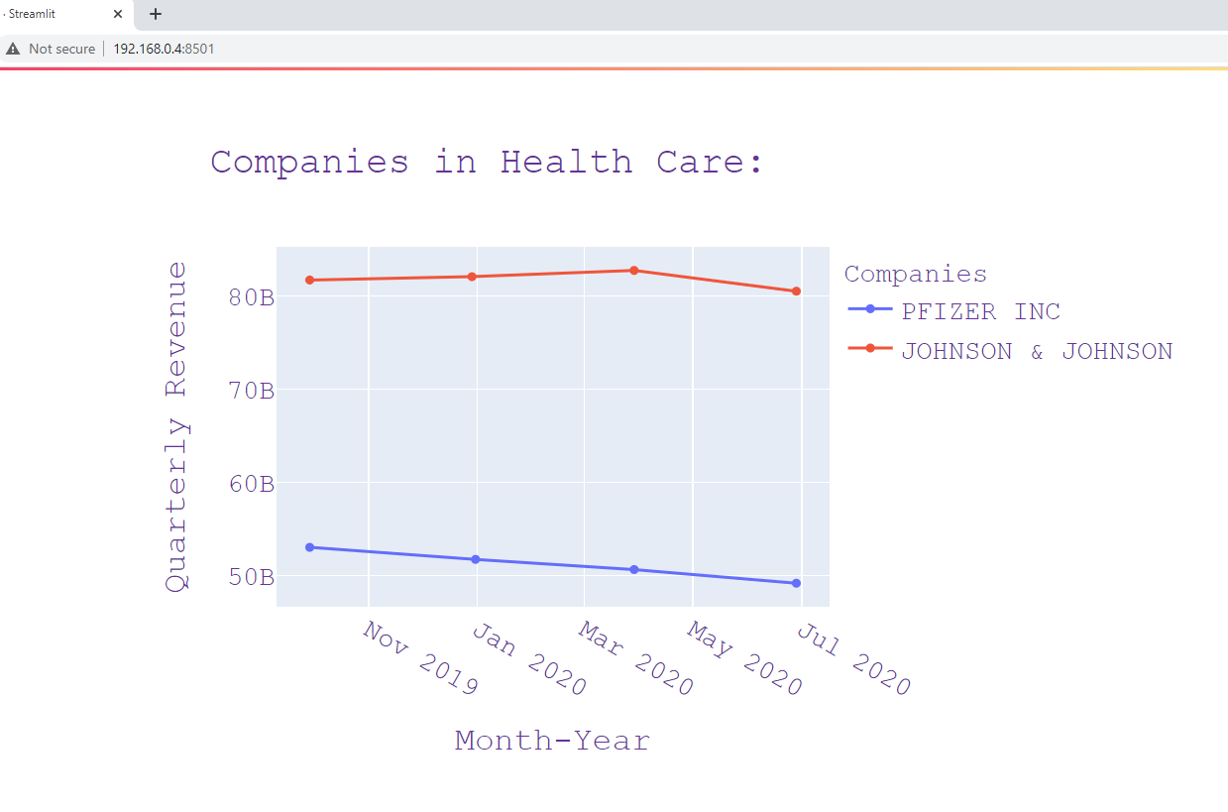
Granular analysis: companies within the same sector

Slide 4
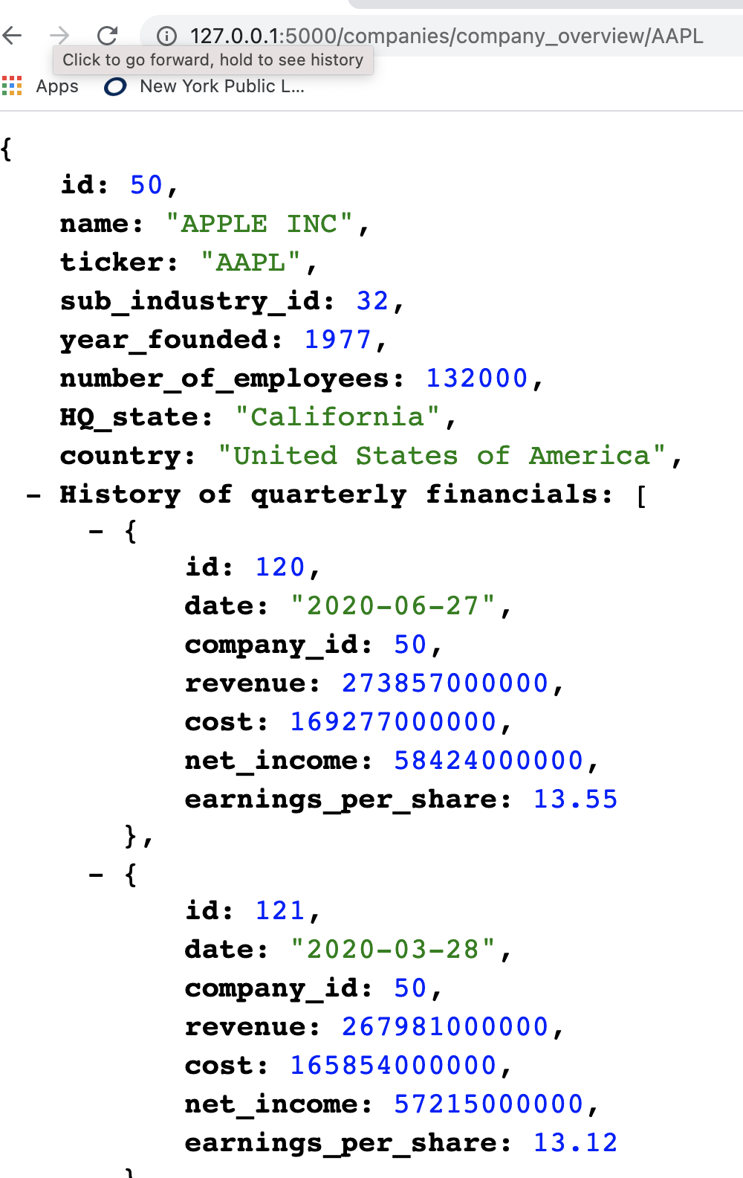
ORM: to_json method

Slide 5
Optimal algorithm to calculate multiple companies’ average Price/Earnings ratio?
Quaterly price/earnings (P/E) ratio
 | Q1 | Q2 | Q3 | Q4
Pfizer | 1 | 2 | 3 | 4
Johnson & Johnson | 5 | 6 | 7 | 8
Raw data, nested list
 | [
 | [1, | 2, | 3, | 4],
 | [5, | 6, | 7, | 8]
 | ]
Result to achieve:
Sector average P/E ratio each quarter | 3 | 4 | 5 | 6

